Slide 1
Welcome
Boot Camp Day 2

Slide 2
Goals for today
Introduction to Objective C
UINavigationBar with UITabbar, Memory Management
Demo: Tab bar Project
Homework: to improve on that project. Add silver points.

Slide 3
Lets refresh our memory!
Hello world Project
Interface Builder/Storyboards
IBActions and how to connect ui elements using outlets
UIApplication and App Delegate

Slide 4
Import Statements
Frameworks that make Cocoa.
#import <Foundation/Foundation.h>
#import <UIKit/UIkit.h>
That line of code is known as an import statement.
The import statement tells the compiler that “when you compile this app, also use the code from this particular file”.
Apple bundles OS features into frameworks. The import statement shown above instructs the compiler to use the Foundation framework, which provides the minimum foundation (as the name suggests) for any app.
Here’s a bit of trivia for you: how many lines of code do you think Foundation/Foundation.h adds to your main.m file? 10? 1000? 100000? A million?
Notes:
Object-oriented
In Xcode, not everything has to be contained in one single file; instead, you can use code contained in separate files.
import statements allow you to pick which features you require for your app to function. This helps to decrease the size of your code, the processing overhead required, and compile time.

Slide 5
Working With Variables
int: stores a whole number, such as 1, 487, or -54.
float: stores a floating-point number with decimal precision, such as 0.5, 3.14, or 1.0
char: stores a single character, such as “e”, “A”, or “$”.
BOOL stores a YES or NO value, also known as a “boolean” value. Other programming languages sometimes use TRUE and FALSE.
NSString, NSNumber, NSInteger
Collections -
NSArray, NSDictionary, NSSet (Immutable)
NSMutableArray, NSMutableDictionary, NSMutableSet (mutable)
Notes:
Objective-C is a very dynamic language. Its dynamism frees a program from compile-time and link-time constraints and shifts much of the responsibility for symbol resolution to runtime, when the user is in control. Objective-C is more dynamic than other programming languages because its dynamism springs from three sources:
· Dynamic typing—determining the class of an object at runtime
· Dynamic binding—determining the method to invoke at runtime
· Dynamic loading—adding new modules to a program at runtime
diff bw nsinteger and int
wrappers around

Slide 6
Working With Conditionals
> : greater than
< : less than
>= : greater than or equal to
<= : less than or equal to
== : equal to
!= : not equal to
if (guess > answer) { NSLog(@"Lower!");}else if (guess < answer) { NSLog(@"Higher!");}else { NSLog(@"Correct! The answer was %i", answer);}

Slide 7
Working With While Loop
while (guess != answer) { // first line to add NSLog(@"Enter a number between 1 and 100"); scanf("%i", &guess); if(guess > answer){ NSLog(@"Lower!"); } else if(guess < answer){ NSLog(@"Higher!"); } else{ NSLog(@"Correct! The answer was %i", answer); }} // second line to add — end of while loop

Slide 8
Functions in Objective C
Instance Level Method
- (NSString*)getUserName:(NSString *) name {
self.name = name;
return self.name;
}
Class level Methods
+ (id)initUser {
self = [super init];
if (self){
self.name = @”John”;
}
return self;
}

Slide 9
Objective-C vs C/C++.
· Objective-C does not have a constructor or destructor. Instead it has init and dealloc methods, which must be called explicitly.
· Objective-C uses + and - to differentiate between class method (known as factory method in Java) and instance methods, C++ uses static to specify a factory method.
· Multiple inheritance is not allowed in Obj-C, however we can use protocol to some extent.
· Obj-C has runtime binding leading to dynamic linking.
· Obj-C has categories.
· Objective-C has a work-around for method overloading, but none for operator overloading.
· Objective-C also does not allow stack based objects. Each object must be a pointer to a block of memory.
· In Objective-C the message overloading is faked by naming the parameters. C++ actually does the same thing but the compiler does the name mangling for us. In Objective-C, we have to mangle the names manually. If you go in deep you will see a complete method names are as : `addA:withB:` which is a selector and `:` is used for parameter.

Slide 10
Big Hoopla - Memory Management !
NO Garbage Collection
Retain and Release Cycle Algorithm
Non ARC - Manual memory management
ARC - Automated Reference Counting (iOS 5 onwards)
Autorelease and AutoReleasePool
Memory Leaks

Slide 11
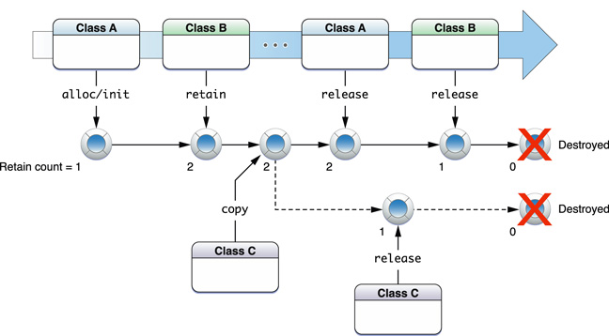
Manual - Memory Referencing
Retain - alloc, copy, new, mutablecopy - Increment Retain Count by 1
Release - release, autorelease (deferred release) - Decrement Retain Count by 1
Notes:
Every object has a RetainCount that goes up by one when the object gets a retain message. It goes down by one when the object gets a release message. When the RetainCount reaches 0, the object will call [self dealloc], thereby releasing the object's memory.
Autorelease pools provide a mechanism whereby you can send an object a “deferred” release message. This is useful in situations where you want to relinquish ownership of an object, but want to avoid the possibility of it being deallocated immediately (such as when you return an object from a method). Typically, you don’t need to create your own autorelease pools, but there are some situations in which either you must or it is beneficial to do so.
Autorelase: By sending an object an autorelease message, it is added to the local AutoReleasePool, and you no longer have to worry about it, because when the AutoReleasePool is destroyed (as happens in the course of event processing by the system) the object will receive a release message, its RetainCount will be decremented, and the GarbageCollection system will destroy the object if the RetainCount is zero.
Release: retain count is decremented at this point.
If RetainingAndReleasing are not properly used then RetainCount for AnObject doesn’t reach 0. It doesn’t crash the application.

Slide 12
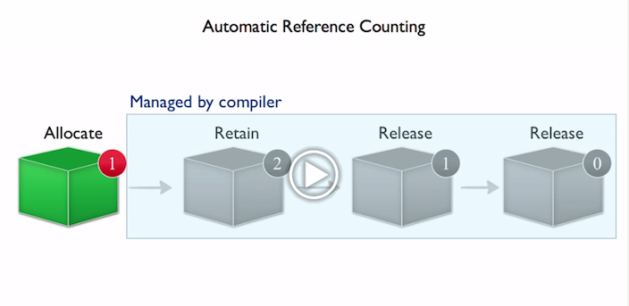
ARC
This will dramatically simplify the development process, while reducing crashes and memory leaks.
The compiler has a complete understanding of your objects and releases each object the instant it is no longer used, so apps run as fast as ever, with predictable smooth performance.
Notes:
ARC for Objective C makes memory management the job of the cmpiler. By enabling ARC with the new Apple LLVM compiler, you will never need to type retain or release again.

Slide 13
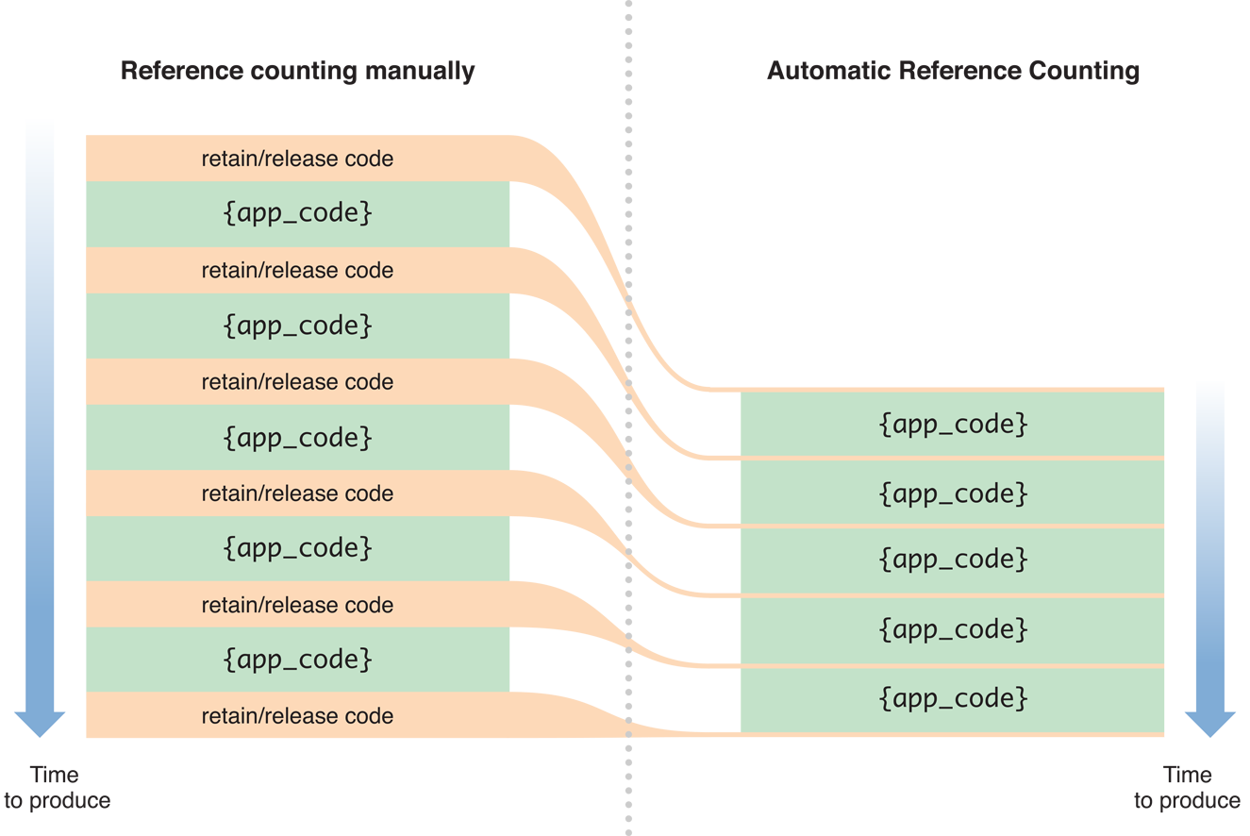
ARC makes life easy!

Slide 14
Memory management in action!
1. Property attributes: nonatomic, atomic (thread safety)
2. Memory access type: copy, retain(strong), assign (weak), readonly, readwrite
@property (strong, nonatomic) NSNumber *number;
Notes:
STRONG IS BY DEFAULT
ATOMIC IS BY DEFAULT
READWRITE IS BY DEAFULT

Slide 15
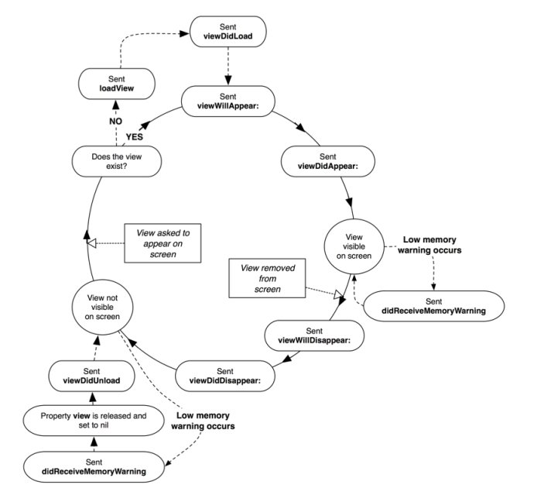
ViewController LifeCycle
loadView
ViewDidLoad
ViewWillAppear
ViewDidAppear
ViewWillDisappear
ViewDidDisappear
ViewDidUnload

Slide 16
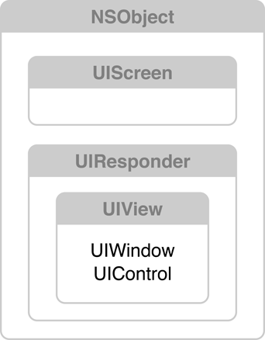
Hiercharchy of UIView

Slide 17
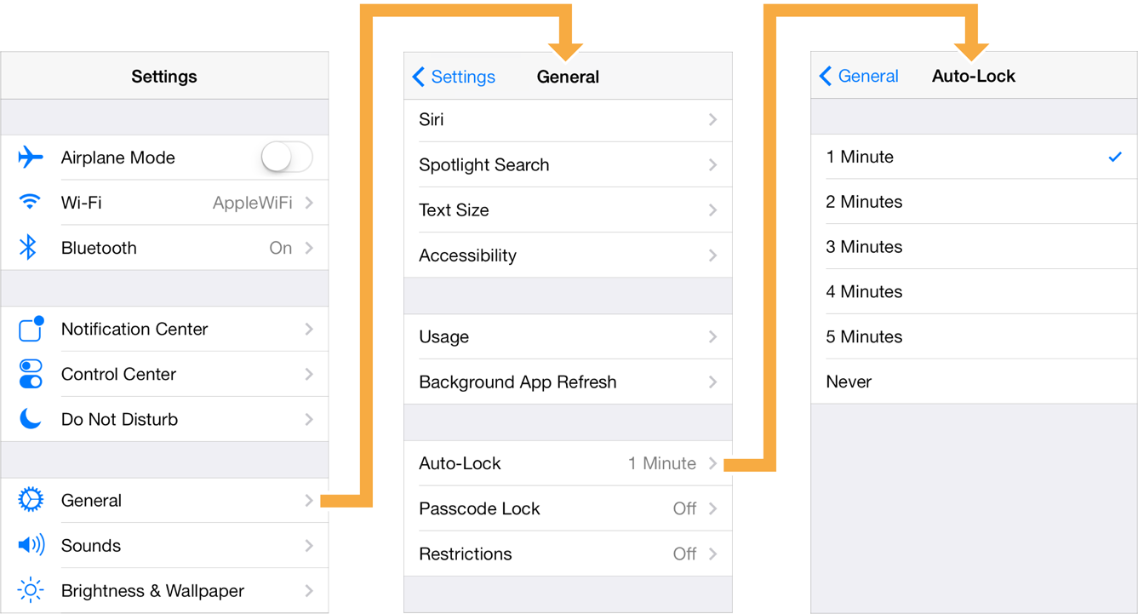
UINavigation
specialized view controller that manages the navigation of hierarchical content.
A navigation controller object manages the currently displayed screens using the navigation stack, which is represented by an array of view controllers.
The first view controller in the array corresponds to the root view controller. The last view controller in the array represents the view controller currently being displayed.
API Methods : pushViewController:animated: and popViewControllerAnimated:

Slide 18
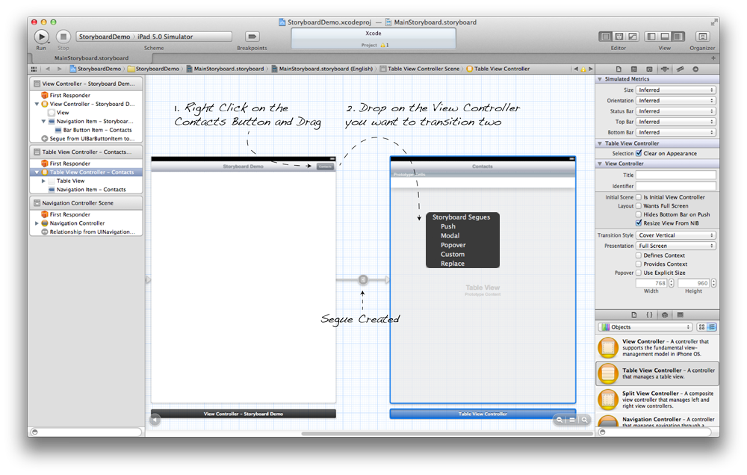
Scene and Seque

Slide 19
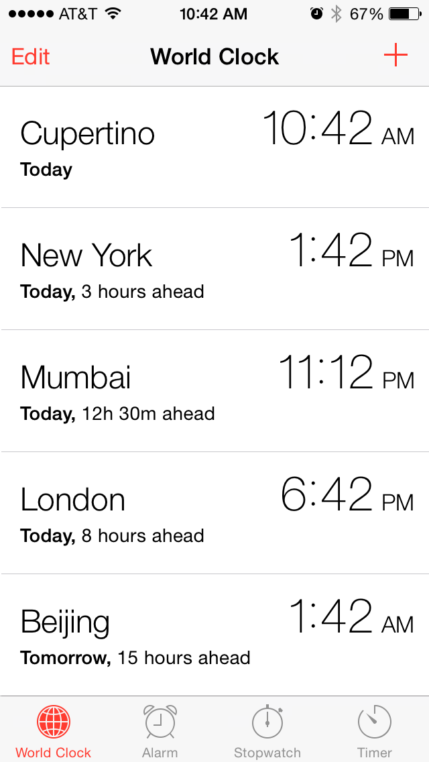
UITabbar
radio-style selection interface
displays tabs at the bottom of the window for selecting between the different modes and for displaying the views for that mode.
Each tab of a tab bar controller interface is associated with a custom view controller.
When the user selects a specific tab, the tab bar controller displays the root view of the corresponding view controller, replacing any previous views.

Slide 20
Sample app using TabBar
Enhance the learn alphabets app through tabs!
Be as creative as possible! You can add anything on tabs!

Slide 21
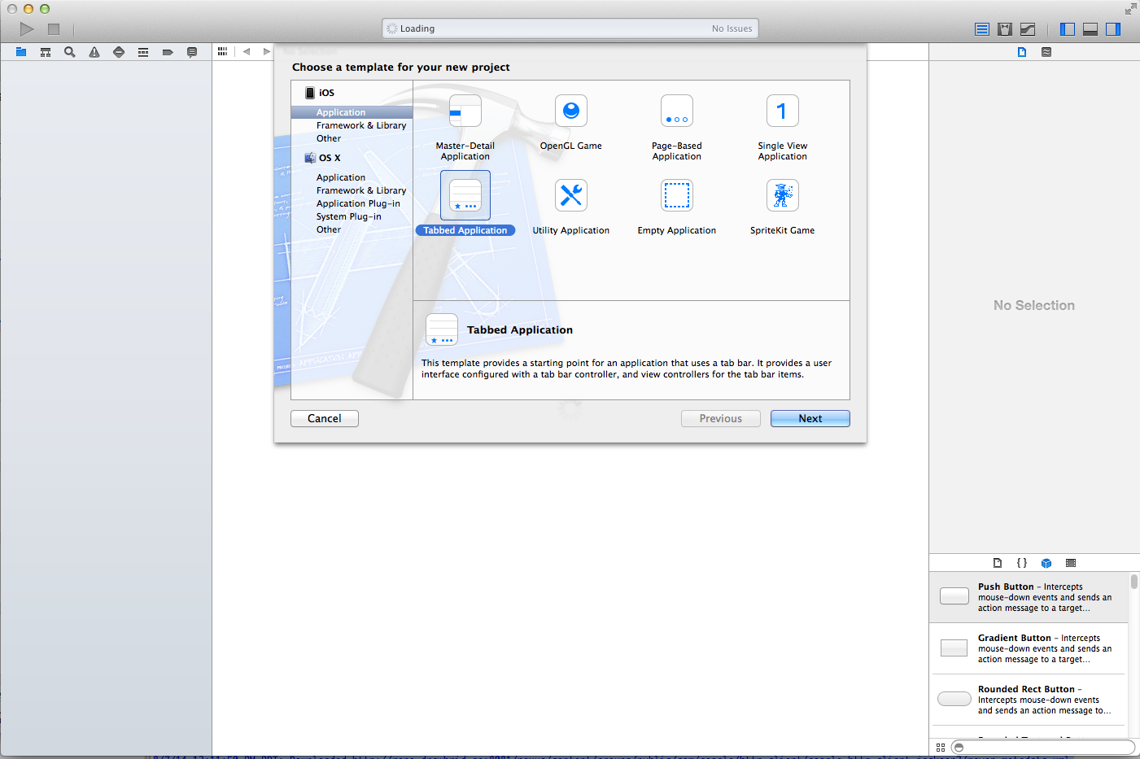

Slide 22
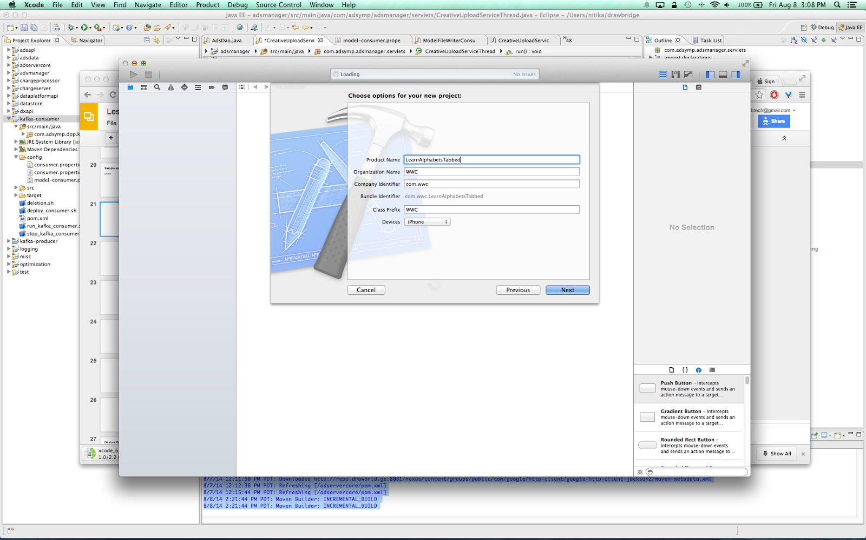
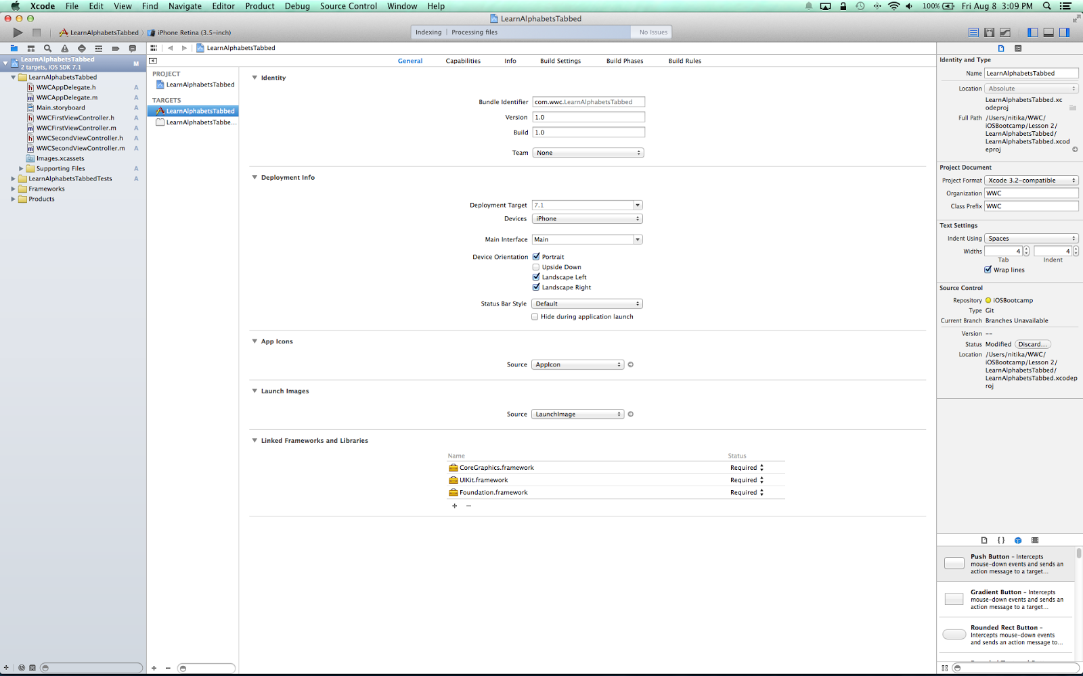
Add app name and check build settings

Slide 23
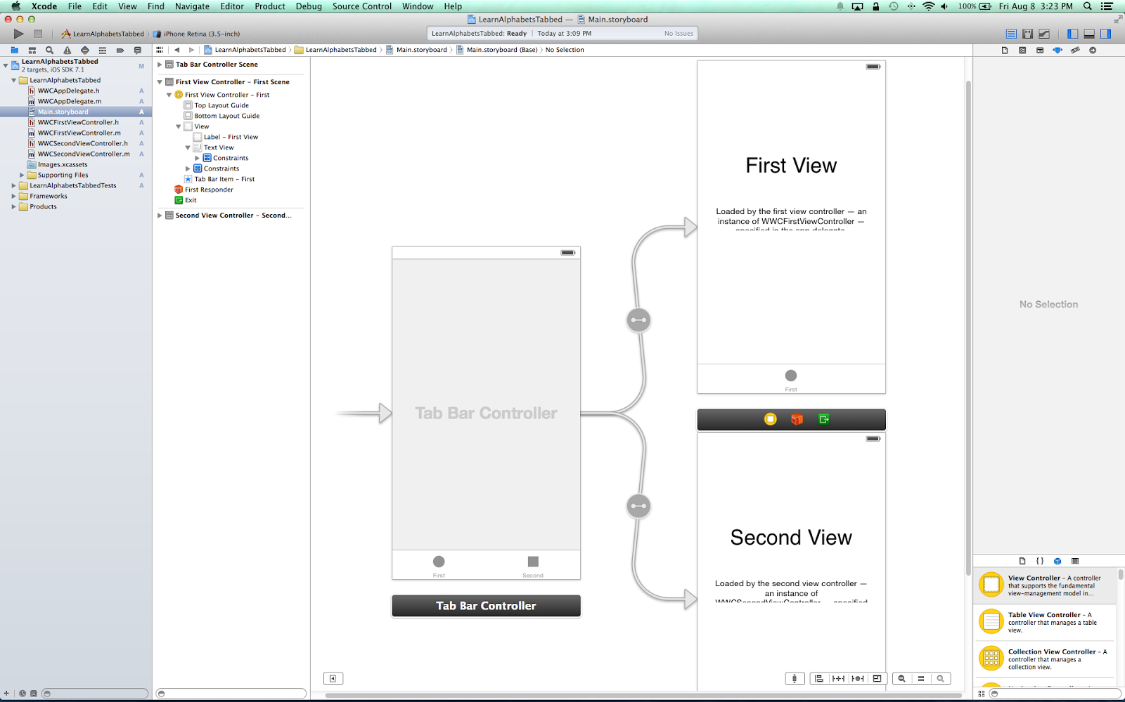
Main.storyboard

Slide 24
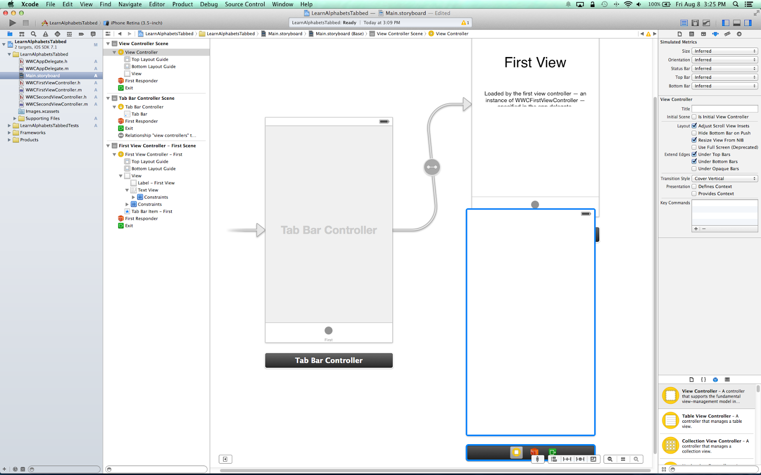

Slide 25
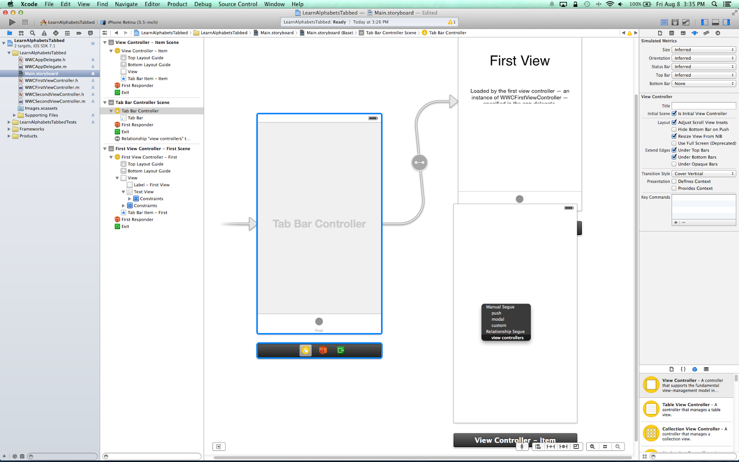
Ctrl+click from tab bar controller to new view controller

Slide 26
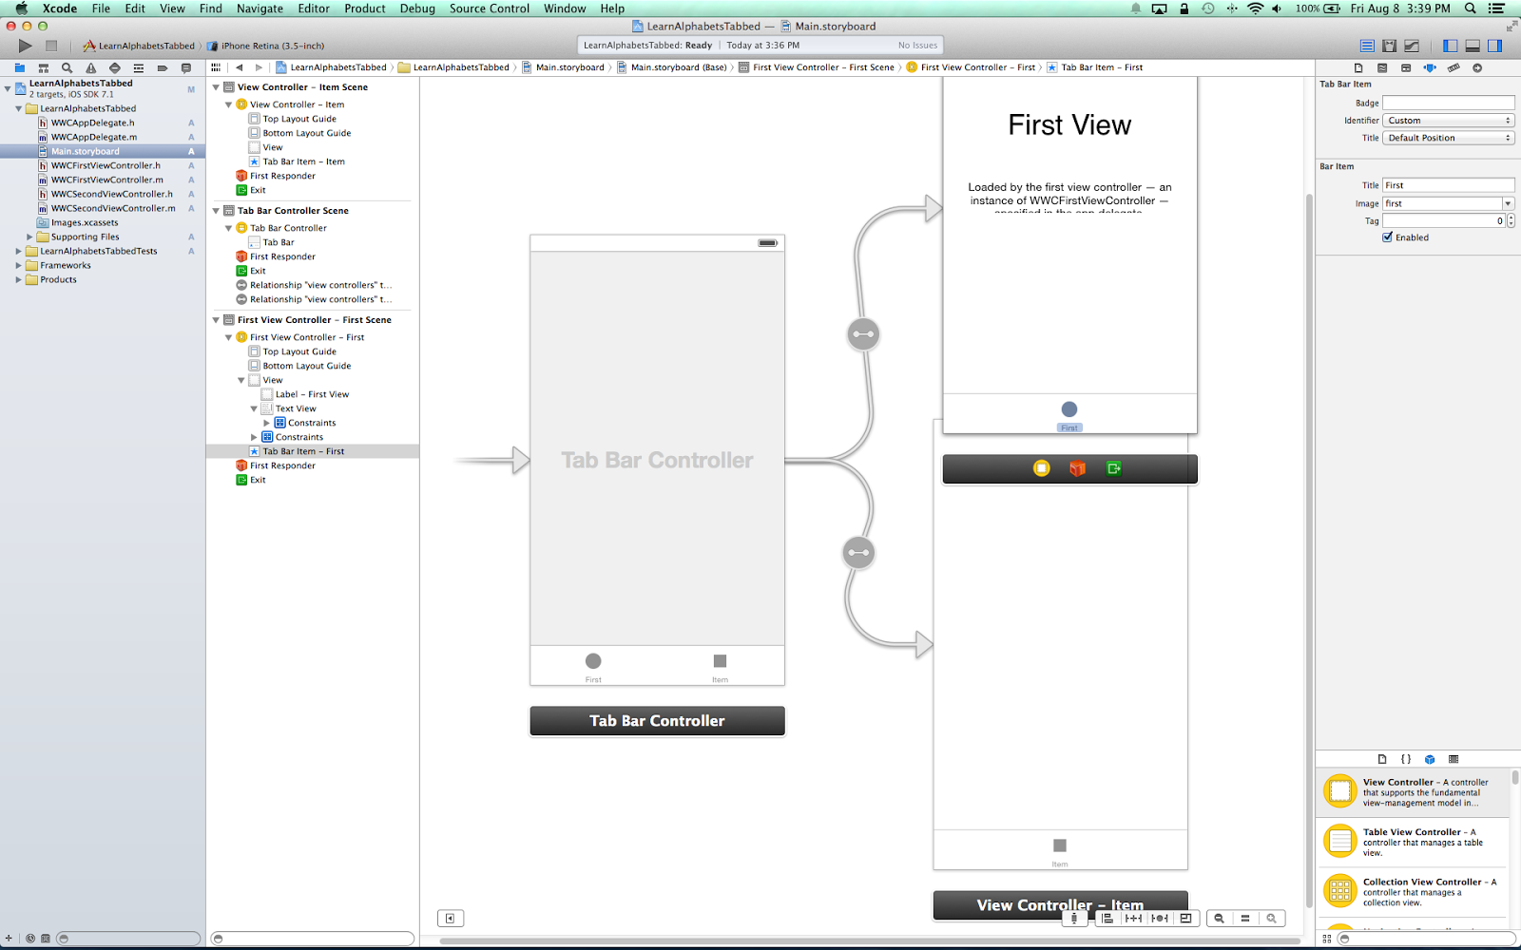
Try changing tab name!

Slide 27
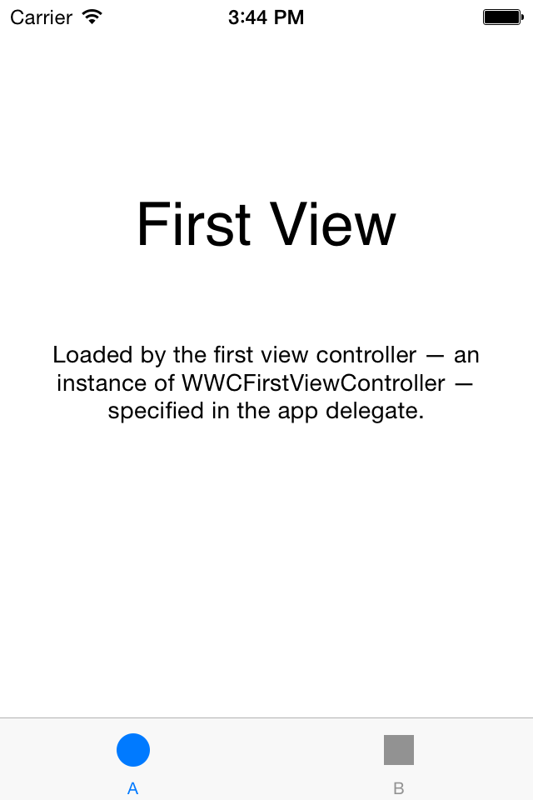

How it looks now!

Slide 28
Lets use previous knowledge!
- Add image views!
- Add images
Launch the app!
p.s.: please see previous Lesson 1 on how to add image views and images to those

Slide 29
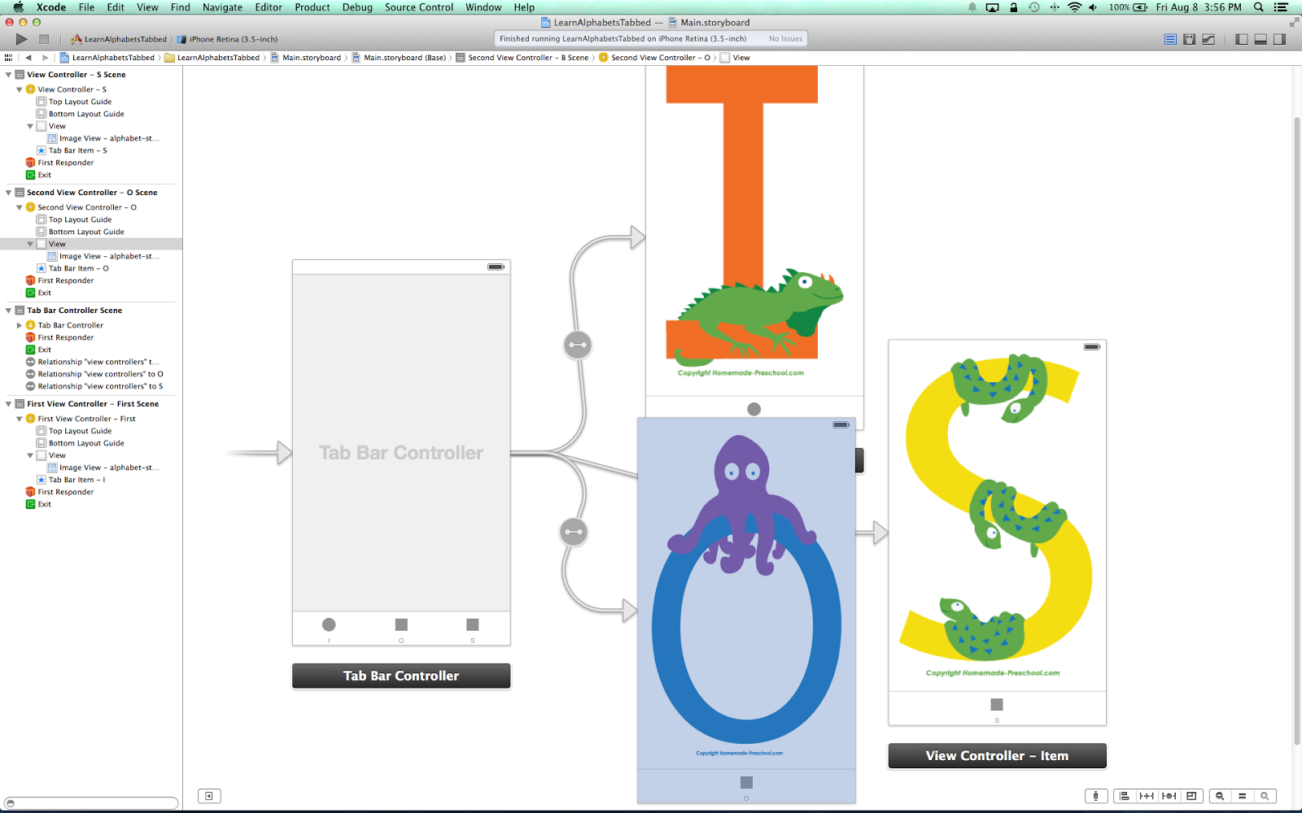

Slide 30

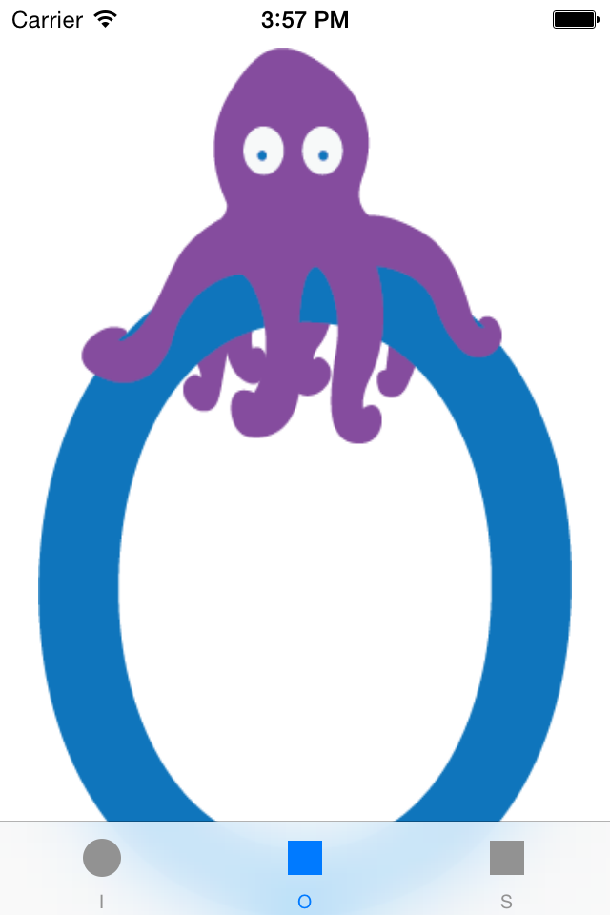


Slide 31
Gesture Recognition
Tap
Swipe (left/right/up/down)
Shake

Slide 32
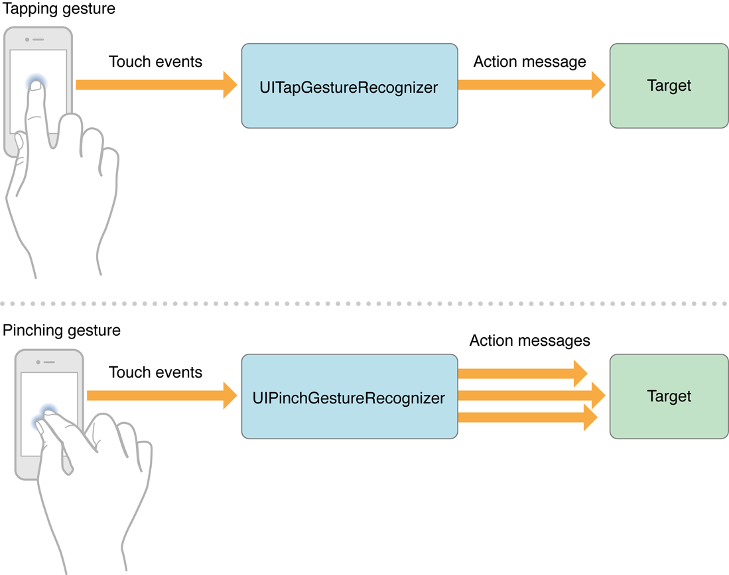
Tapping and Pinch Gesture

Slide 33
Adding Tap Gesture to View
// -----------------------------// One finger, two taps// -----------------------------
-(void)ViewDidLoad{// Create gesture recognizer UITapGestureRecognizer *oneFingerTwoTaps = [[UITapGestureRecognizer alloc] initWithTarget:self action:@selector(oneFingerTwoTaps)]; // Set required taps and number of touches[oneFingerTwoTaps setNumberOfTapsRequired:2];[oneFingerTwoTaps setNumberOfTouchesRequired:1]; // Add the gesture to the view[[self view] addGestureRecognizer:oneFingerTwoTaps];
}
- (void)oneFingerTwoTaps{ NSLog(@"Action: One finger, two taps");}

Slide 34
Homework
Add swipe, shake gesture to your project. Have fun!

Slide 35
Question

Slide 36
Feedback

Slide 37
Thank you !

